Slide 1

Exam AZ-400: Microsoft Azure DevOps Solutions Crash Course
Tim Warner @TechTrainerTim

Slide 2


Tim Warner
Based in Nashville, TN, US
MCT, MVP
Twitter: @TechTrainerTim
Badge: timw.info

Slide 3
Session 1 of 2 Learning Goals
Develop a SRE strategy (5-10%)
Develop a security & compliance plan (10-15%)
Manage source control (10-15%)
Develop an instrumentation strategy (5-10%)

Slide 4
Session 2 of 2 Learning Goals
Define and implement CI pipelines (20-25%)
Define and implement a CD/RM strategy (10-15%)
Facilitate communication & collaboration (10-15%)
AZ-400 exam tips & tricks throughout!

Slide 5
Course Materials
timw.info/az400

Slide 6
Setting Expectations
This is a six-hour "crash course"
Please plan to review these materials more than once
Five-minute break at midpoint
Please ask/answer questions and provide feedback in the Q/A panel, not the group chat
I'll post outstanding questions/answers to my Twitter feed: @TechTrainerTim

Slide 7
A Surgical Approach
I have cleared the AZ-400 exam on 11 April 2020
timw.info/qyf
I have studied the major AZ-400 practice exams
MeasureUp
WhizLabs
I have distilled the subject down to the essential elements covered on the AZ-400 exam

Slide 8

Session Recordings

Slide 9
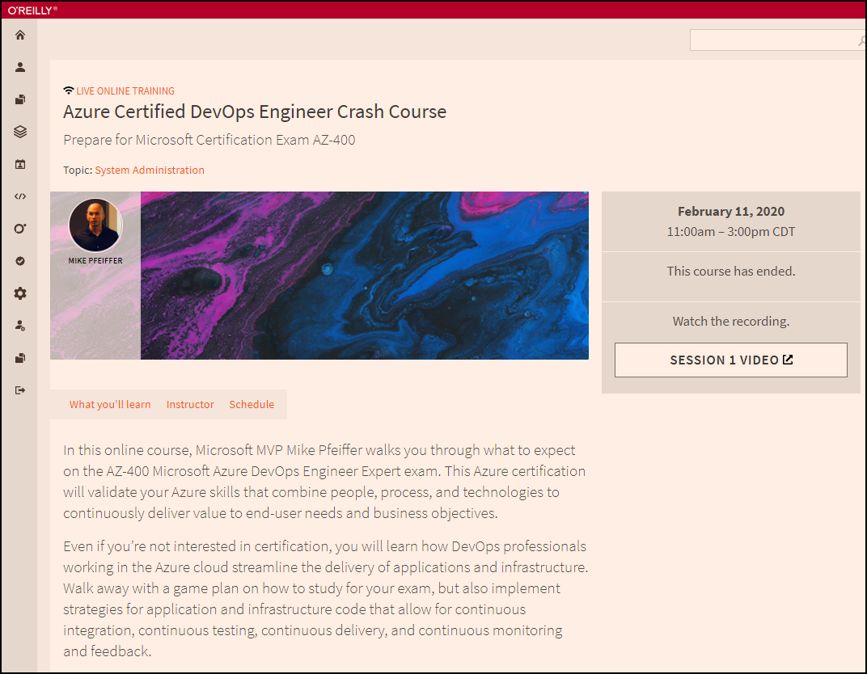
Session Recordings

Slide 10

Session Recordings

Slide 11
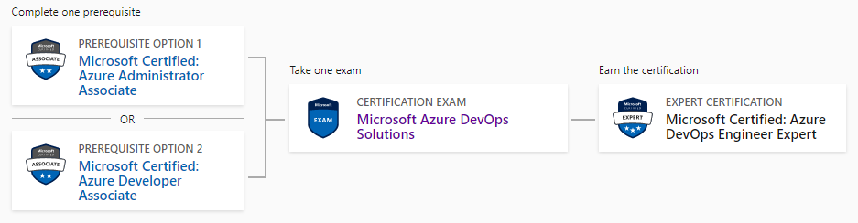
DevOps Engineer Expert Certification
AZ-104
AZ-400
AZ-204

Slide 12
Tim's Suggested Certification Strategy
Clear Exam AZ-104, Microsoft Azure Administrator, first
You need those core infrastructure skills
JSON, PowerShell
Monitoring
Then clear Exam AZ-400
AZ-400 is about development principles, not programming
This course gives you the dev foundations
You need to already have the ops foundations

Slide 13
Develop an SRE Strategy

Slide 14
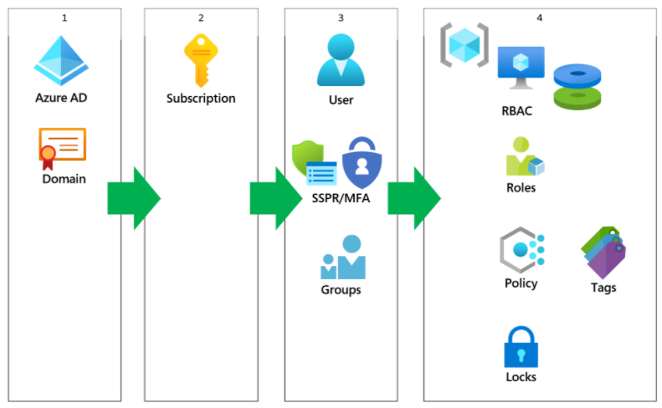
Azure AD Identity

Slide 15
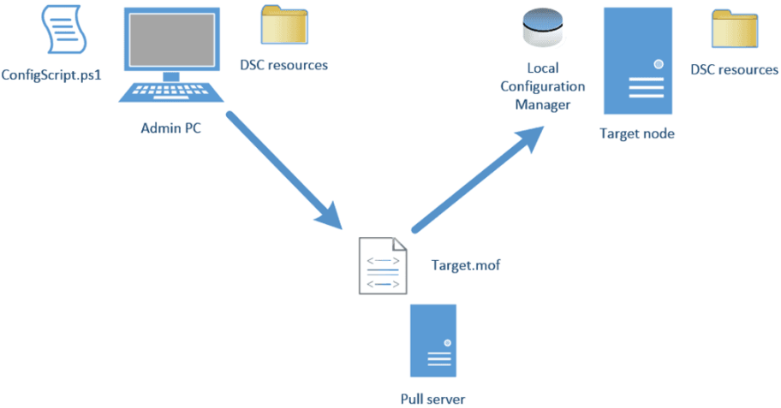
Azure Automation DSC

Slide 16
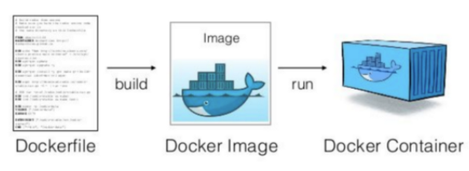
Docker Container Development Process

Slide 17
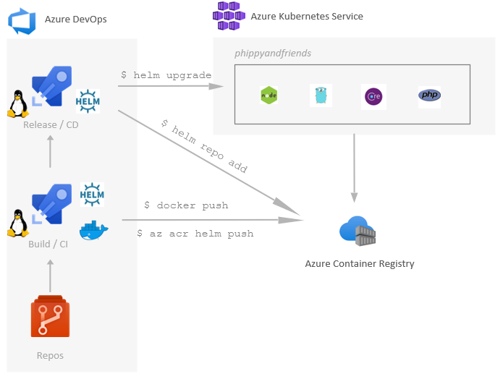
Helm, ACR, and AKS

Slide 18
Develop a Security and Compliance Plan

Slide 19
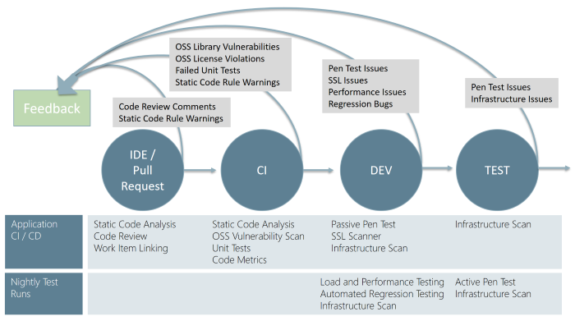
Continuous Security Validation

Slide 20
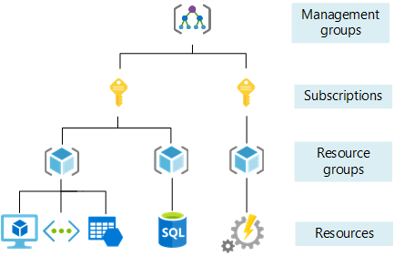
Azure Management Scopes

Slide 21
Manage Source Control

Slide 22
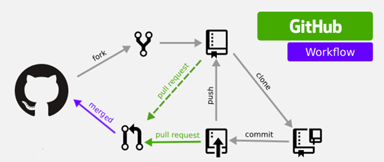
GitHub Workflow

Slide 23
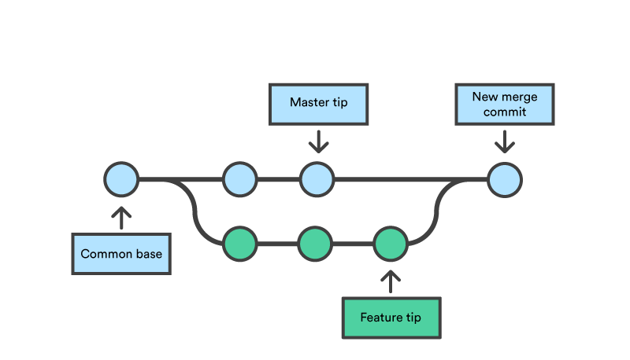
Feature Branching and Merging

Slide 24
Thank you!
Course materials: timw.info/az400
Twitter: @TechTrainerTim
Work: timw.info/ps
Web: TechTrainerTim.com

Slide 25
Exam AZ-400 Exam Strategy

Slide 26
Tim's Certification Study Pyramid
Interdependence
Content knowledge
Practical application
Test-taking skills

Slide 27
Preparing for Online Testing

Slide 28

Why Microsoft Online Testing?
COVID means Pearson VUE physical testing centers are unavailable
The Pearson OnVUE client has come a LONG way
I'll use online testing exclusively from now on

Slide 29
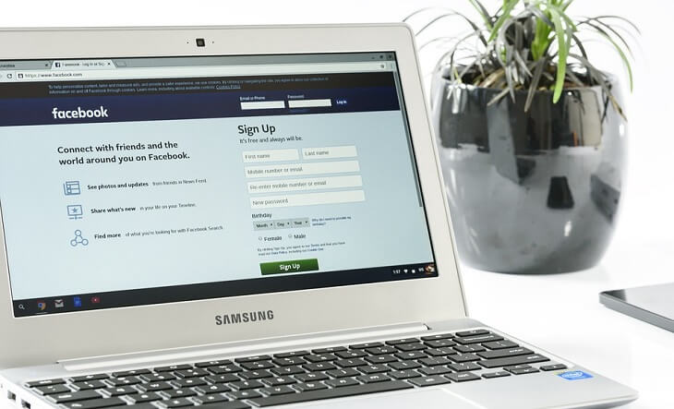
Pearson OnVUE System Requirements
Windows 10 / Windows 8.1
macOS High Sierra (10.13)
4 GB RAM
1024x768/16 resolution
1920x1080/32 recommended
Touchscreens are prohibited

Slide 30

Pearson OnVUE System Requirements
3 Mbps down/up network bandwidth
Mobile hotspot tethering is prohibited
Browsers:
IE 11, Edge, Chrome, Firefox, or Safari (latest versions)

Slide 31

Pearson OnVUE System Requirements
Webcam: 640x480/10 fps
Microphone: integrated
Headsets not allowed
Corporate VPNs, firewalls, and proxies will likely disrupt the delivery
Check with networking team first

Slide 32
Your Pre-Exam Checklist
Computer set up
Kill all tasks except for your browser
May need to use Task Manager or Activity Monitor
Additional monitors turned off
Mobile phone
ID

Slide 33
During the Exam
Keep your face in the webcam frame
Keep your hands away from your mouth
Ensure you aren't interrupted
Walled room
Door closed
No bio breaks are allowed

Slide 34
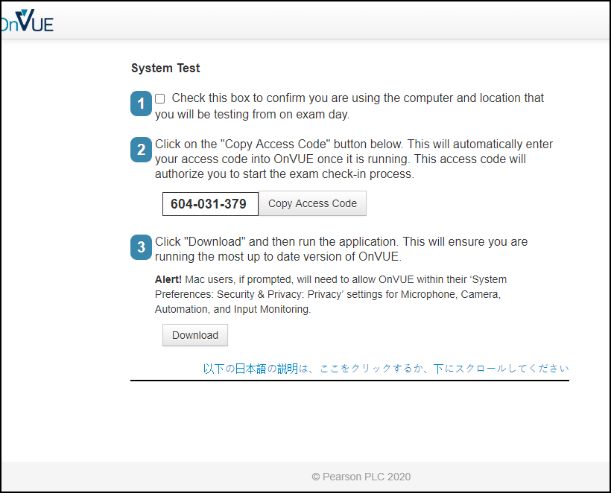

Slide 35
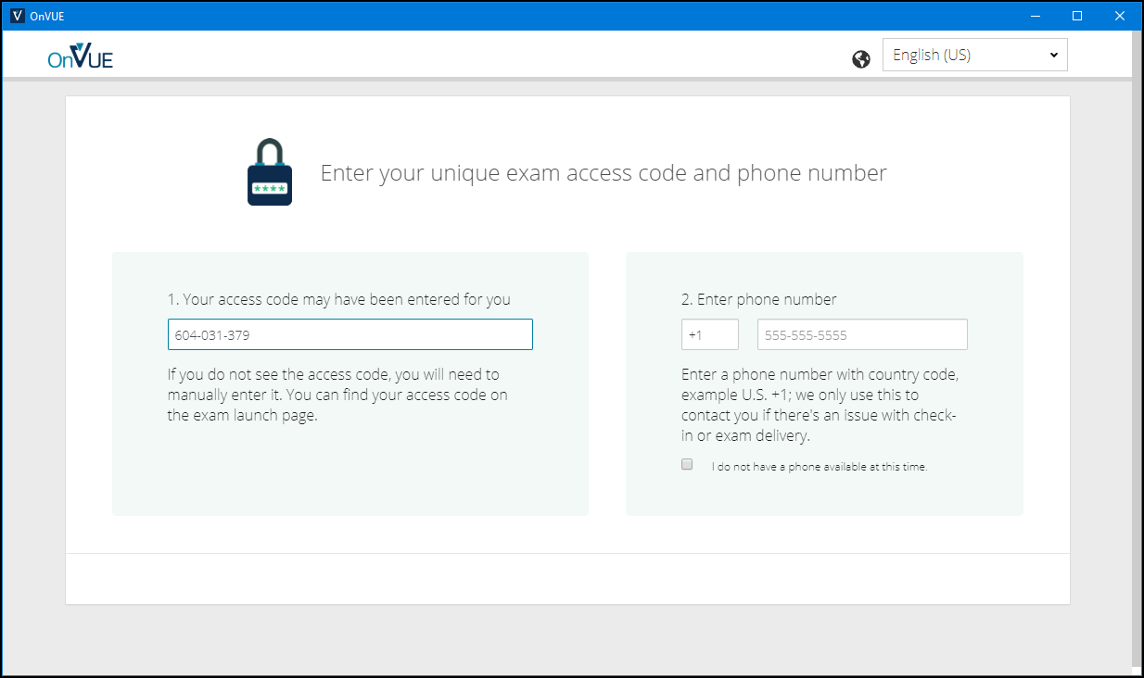

Slide 36
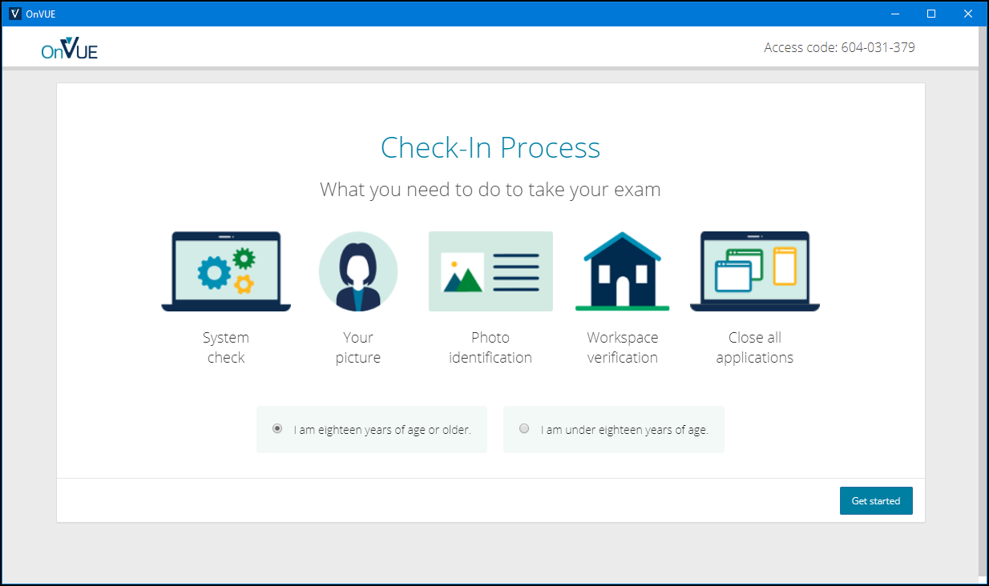

Slide 37
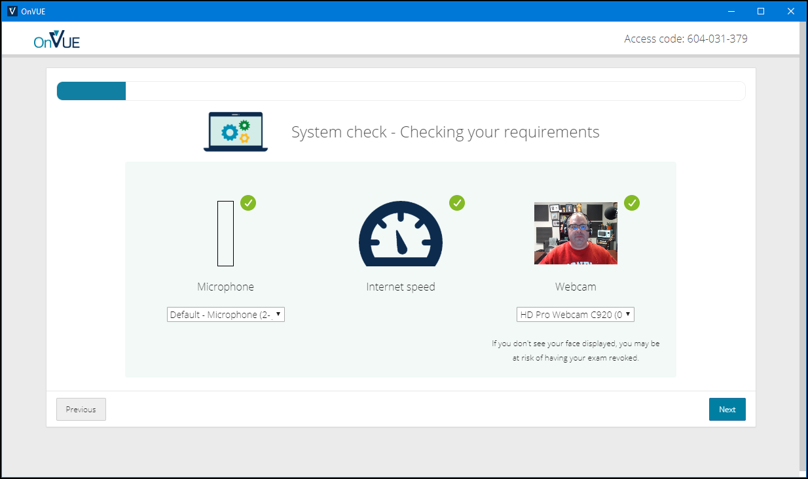

Slide 38
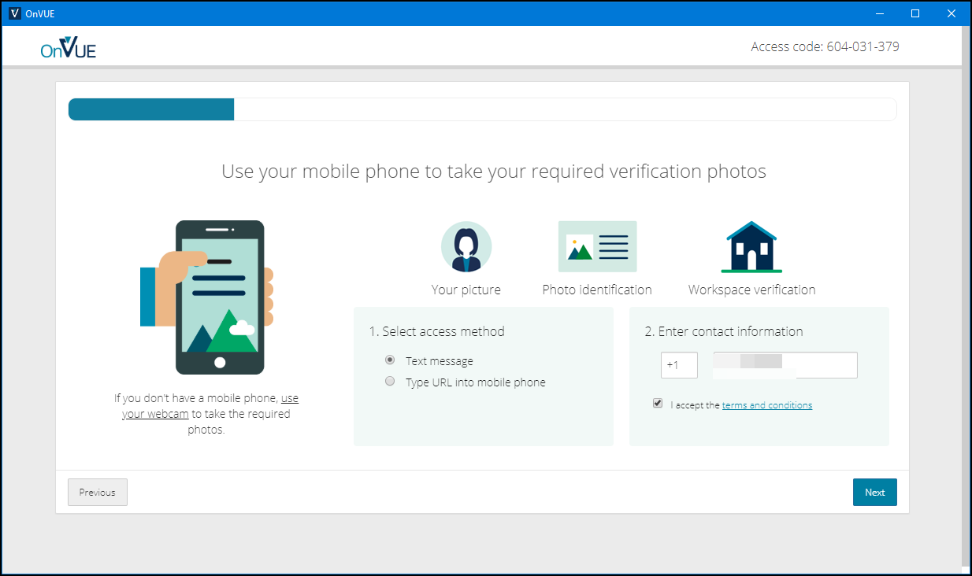

Slide 39
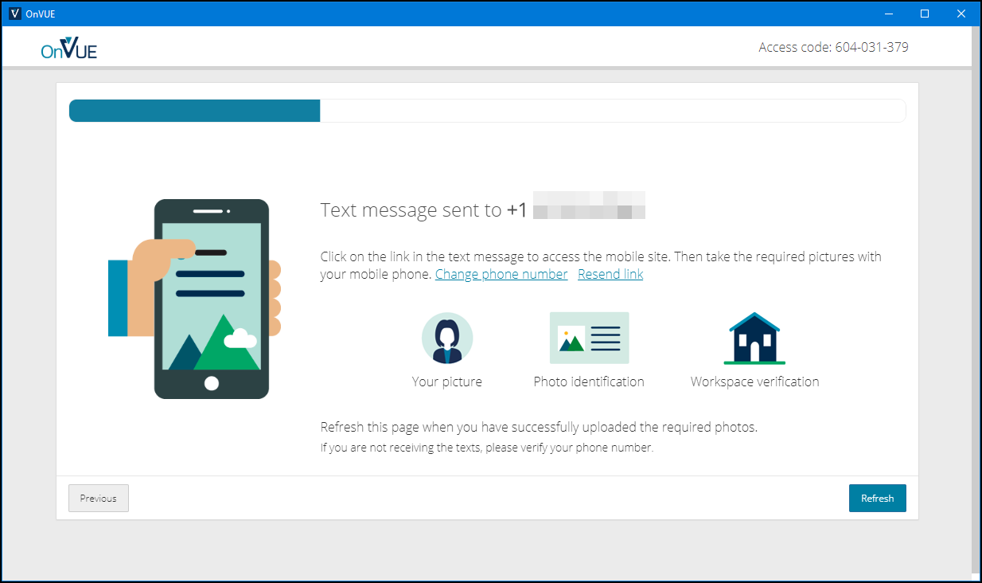

Slide 40
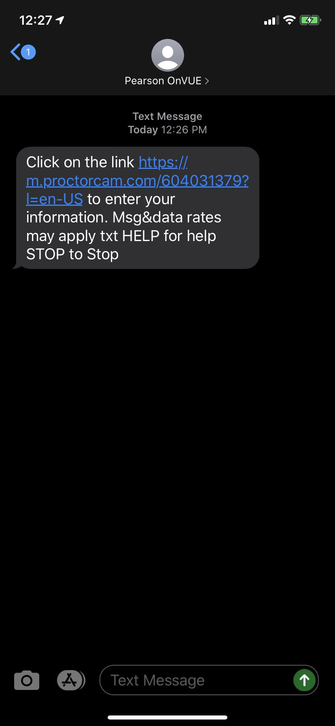
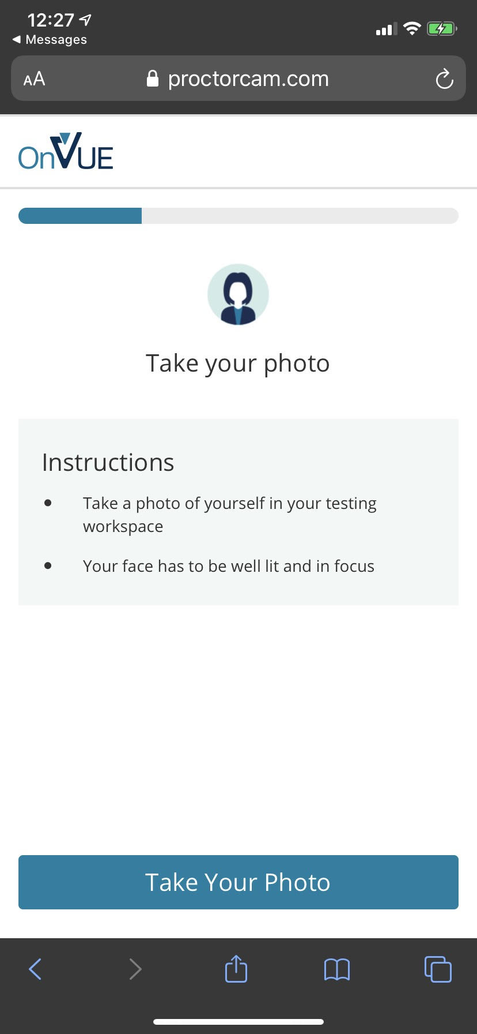
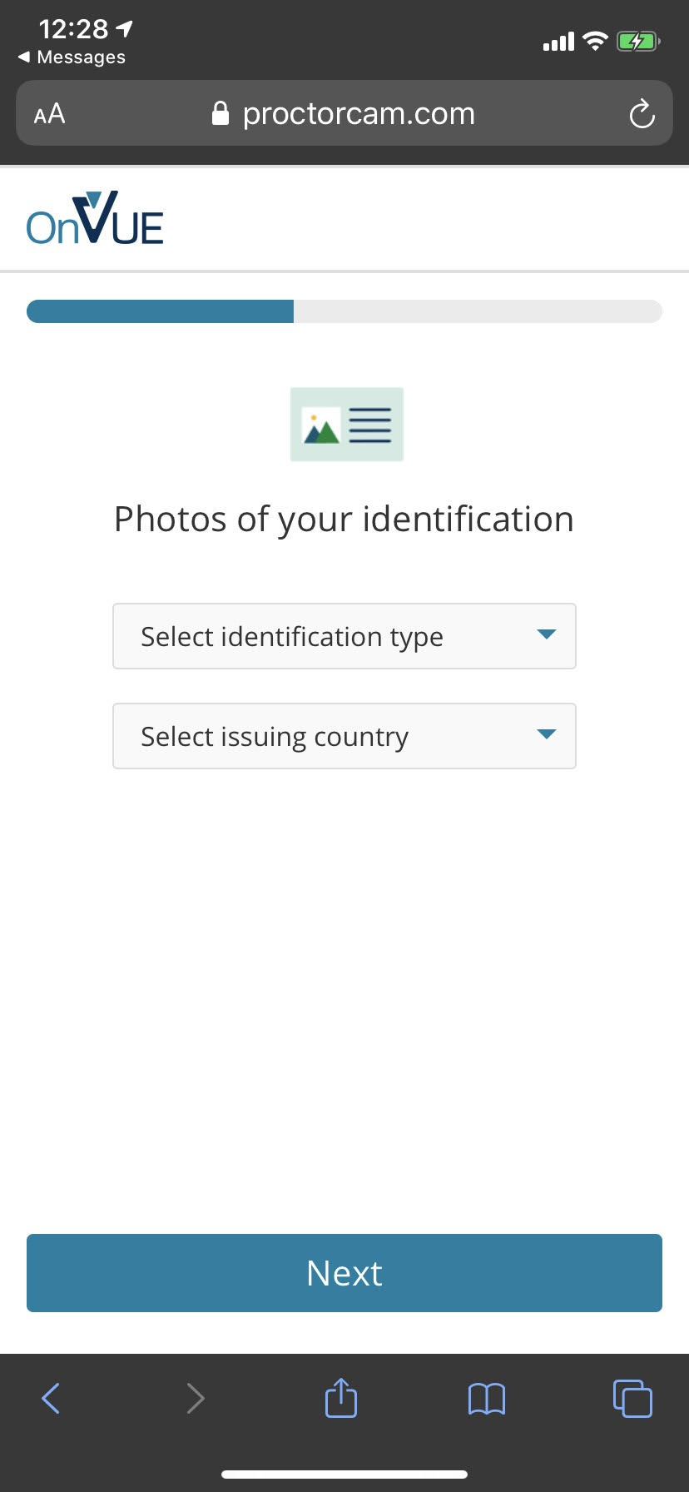

Slide 41
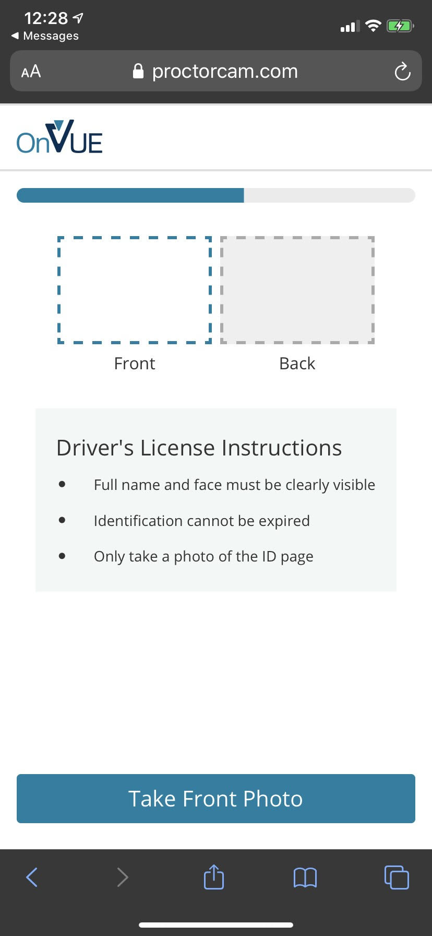
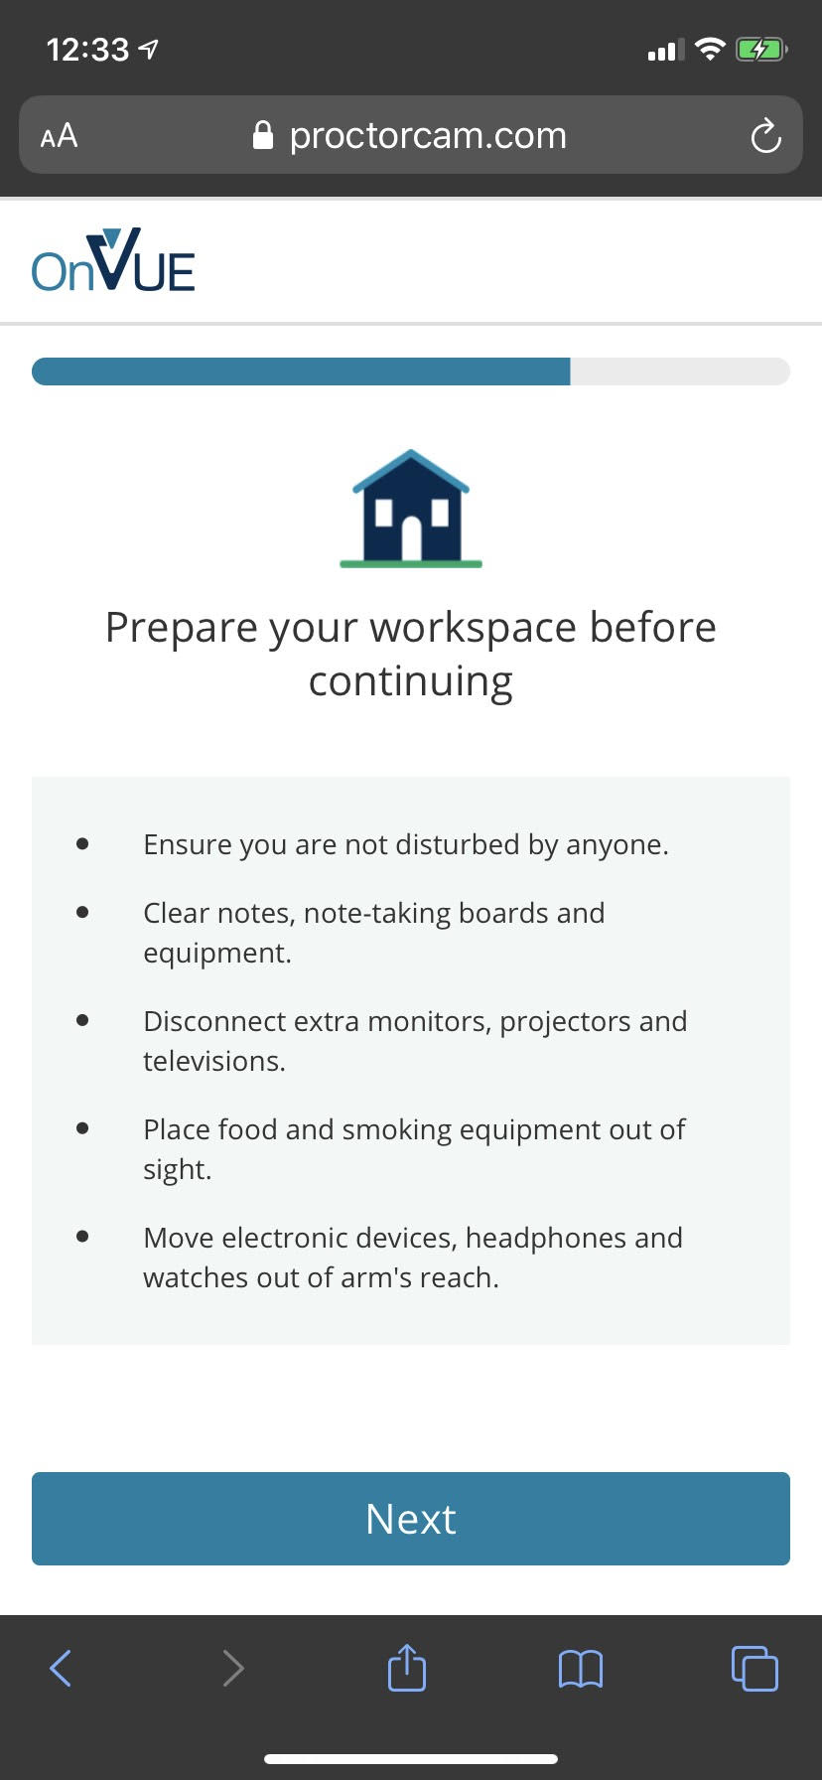

Slide 42
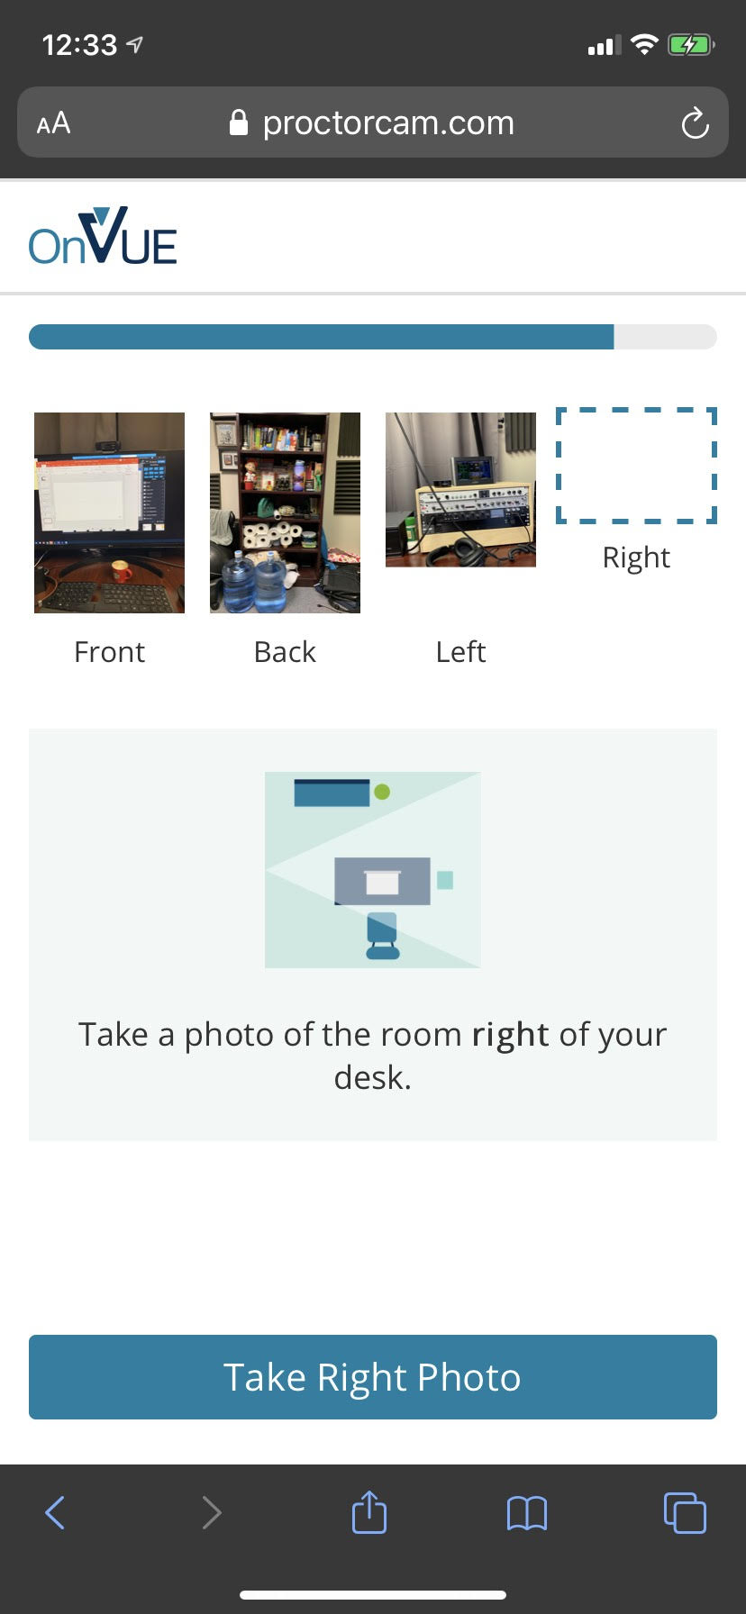
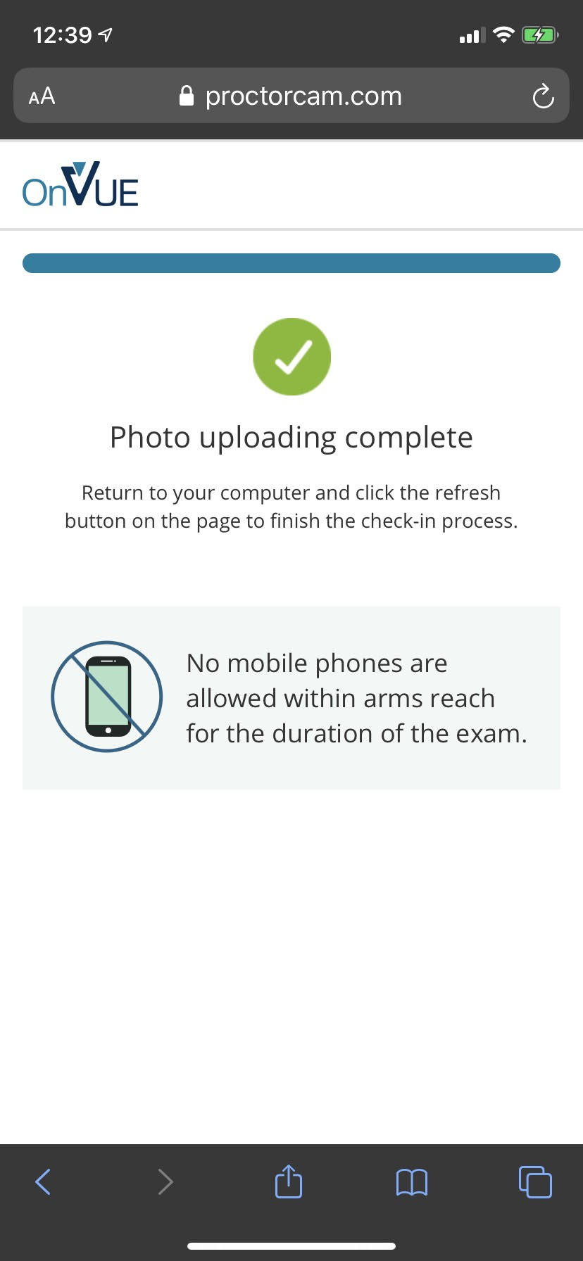

Slide 43
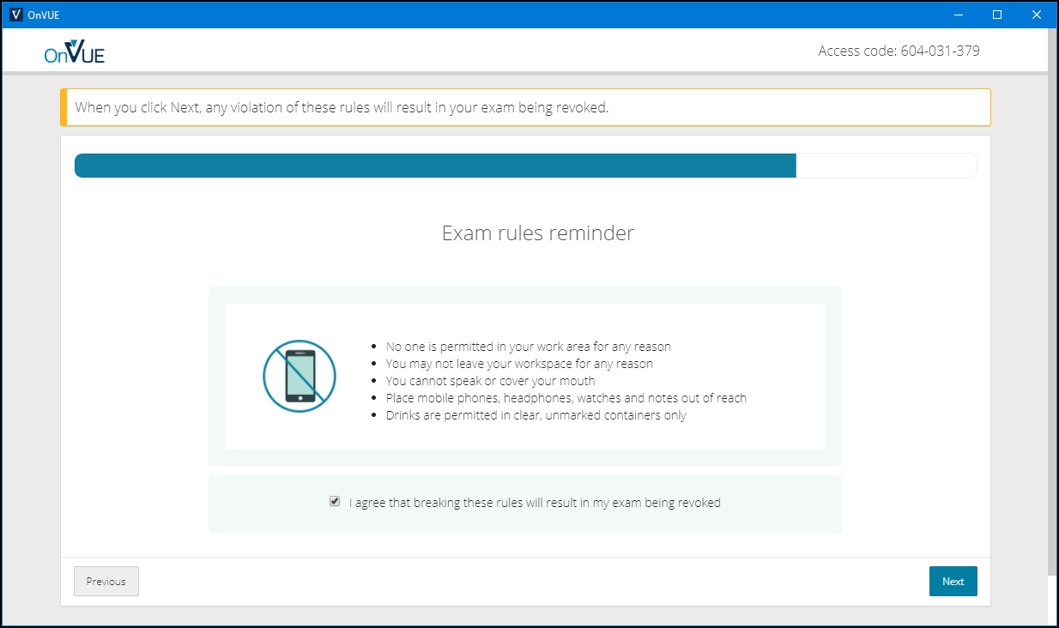

Slide 44
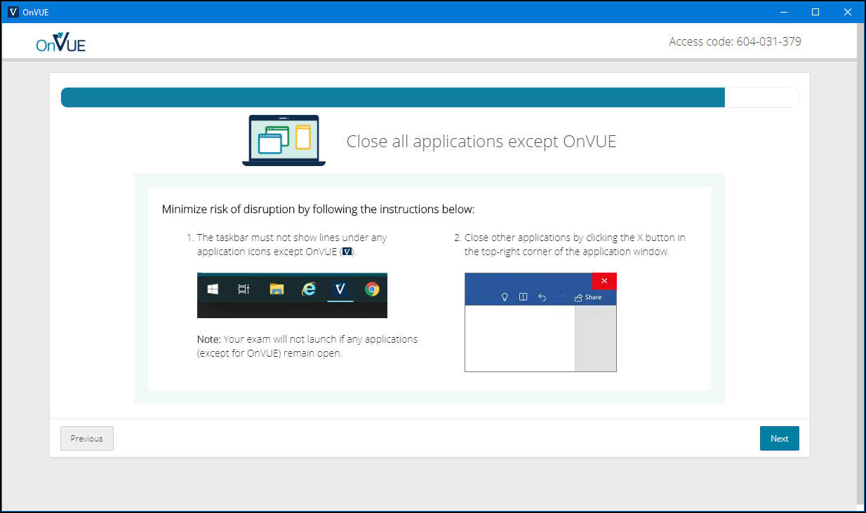

Slide 45
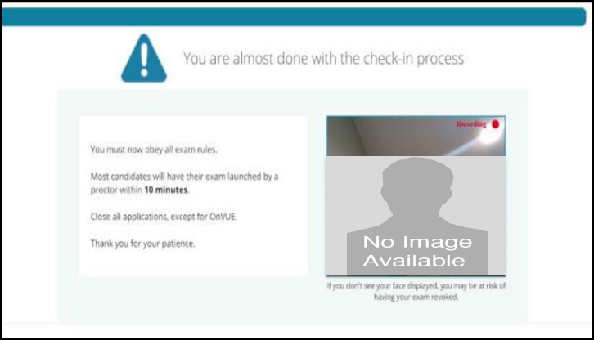

Slide 46
AZ-400 Exam Tips
Expect to see a lot of JSON, PowerShell, and Azure CLI
Expect NOT to see C# or JavaScript
It doesn't matter which exam order you use:
AZ-203
AZ-103/AZ-104
AZ-400
Perform due diligence in validating your environment for Microsoft online testing

Slide 47
Thank you!
Course materials: timw.info/az400
Twitter: @TechTrainerTim
Work: timw.info/ps
Web: TechTrainerTim.com

Slide 48
Exam AZ-400 Exam Strategy

Slide 49
Tim's Certification Study Pyramid
Interdependence
Content knowledge
Practical application
Test-taking skills

Slide 50
AZ-400 Item Types

Slide 51

Single Answer Multiple Choice

Slide 52
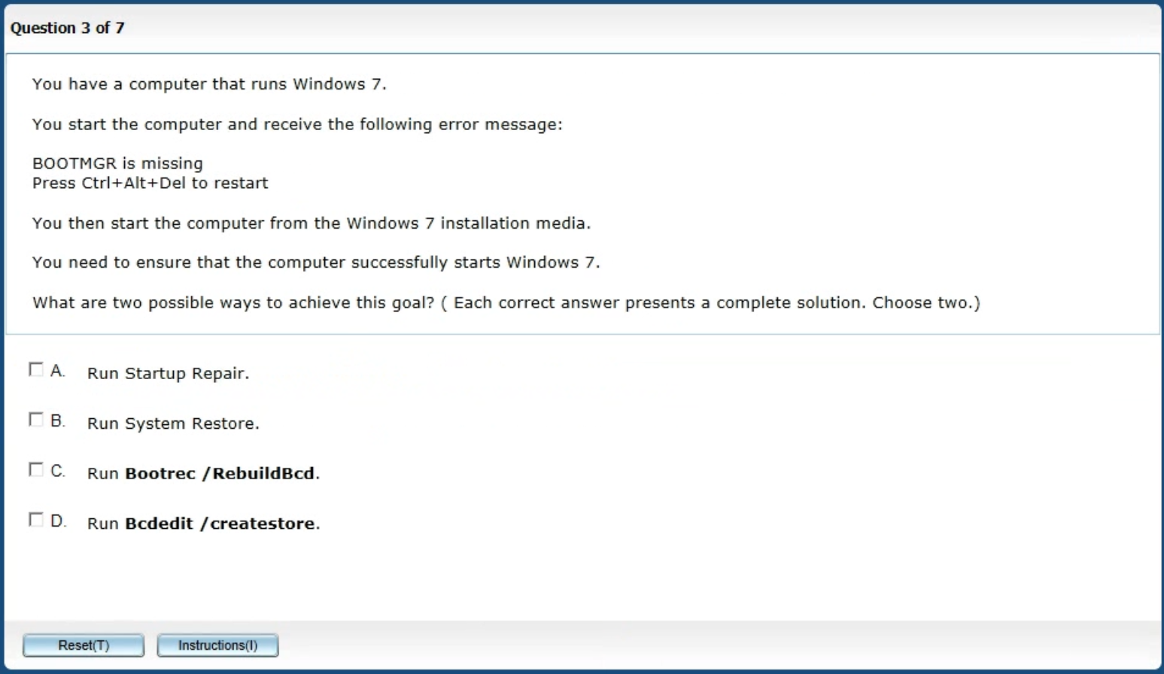
Multiple Answer Multiple Choice

Slide 53
Repeated Scenario
You need to move an Azure VM to another hardware host.
Solution: You redeploy the VM.
Does this solution meet the goal?
Yes
No

Slide 54
Repeated Scenario
You need to move an Azure VM to another hardware host.
Solution: You restart the VM.
Does this solution meet the goal?
Yes
No

Slide 55

Select and Place

Slide 56

Build List and Reorder

Slide 57

Active Screen/Fill in the Blank

Slide 58

Case Study

Slide 59






Performance-Based Lab

Slide 60
Preparing for Online Testing

Slide 61
Why Microsoft Online Testing?
COVID means Pearson VUE physical testing centers are unavailable
The Pearson OnVUE client has come a LONG way
I'll use online testing exclusively from now on

Slide 62
Pearson OnVUE System Requirements
Windows 10 / Windows 8.1
macOS High Sierra (10.13)
4 GB RAM
1024x768/16 resolution
1920x1080/32 recommended
Touchscreens are prohibited

Slide 63
Pearson OnVUE System Requirements
3 Mbps down/up network bandwidth
Mobile hotspot tethering is prohibited
Browsers:
IE 11, Edge, Chrome, Firefox, or Safari (latest versions)

Slide 64
Pearson OnVUE System Requirements
Webcam: 640x480/10 fps
Microphone: integrated
Headsets not allowed
Corporate VPNs, firewalls, and proxies will likely disrupt the delivery
Check with networking team first

Slide 65
Your Pre-Exam Checklist
Computer set up
Kill all tasks except for your browser
May need to use Task Manager or Activity Monitor
Additional monitors turned off
Mobile phone
ID

Slide 66
During the Exam
Keep your face in the webcam frame
Keep your hands away from your mouth
Ensure you aren't interrupted
Walled room
Door closed
No bio breaks are allowed

Slide 67
Demo
asdf

